Slide 1


Neutron diffraction method and experimental capabilities at FLNP JINR
Roman Vasin
Frank Laboratory of Neutron Physics, Joint Institute for Nuclear Research
2025

Slide 2
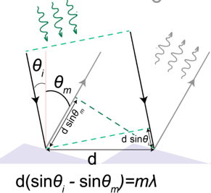
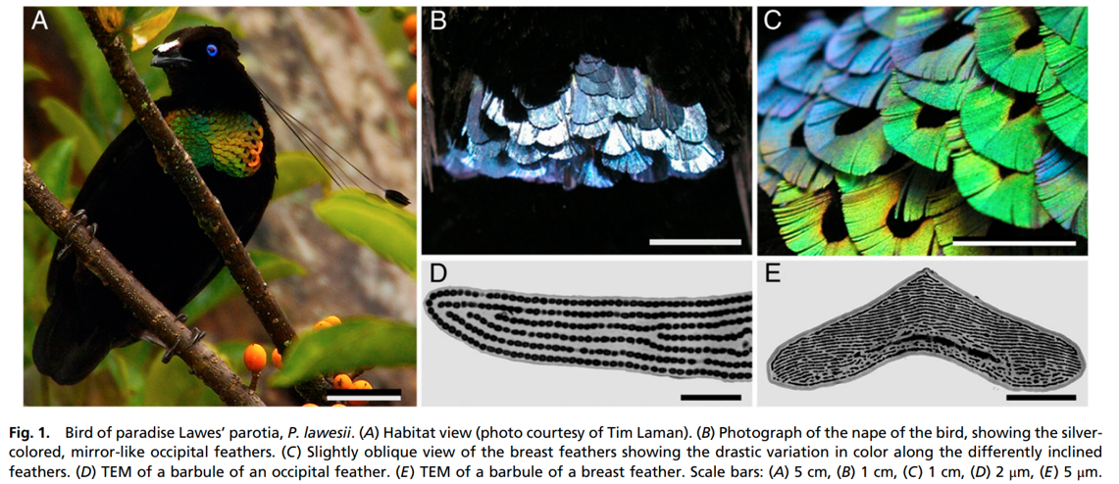
Diffraction grating
Reflecting diffraction grating
Visible light: ≈ 380-780 nm.
Ordered layers of melanosomes surrounded by a keratin cortex.
B.D. Wits et al. (2014). PNAS, 111(12), 4363-4368.
Notes:
The structural coloration of both the occipital and breast feathers of the bird-of-paradise Lawes’ parotia is produced by melanin rodlets arranged in layers, together acting as interference reflectors. The feather barbules of both the breast and nape area contain well-ordered layers of melanosomes surrounded by a keratin cortex (Fig. 1 D and E).
Меланосома — это органелла, содержащаяся в клетках царства животных, имеющая в составе меланин и другие светопоглощающие пигменты.
Кератины — семейство фибриллярных белков, обладающих механической прочностью, которое среди материалов биологического происхождения уступает лишь хитину. В основном из кератинов состоят роговые производные.

Slide 3
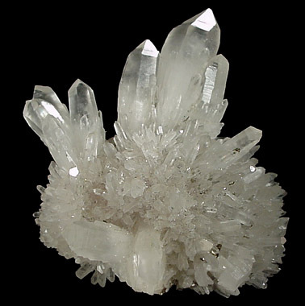
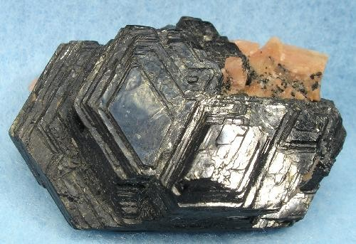
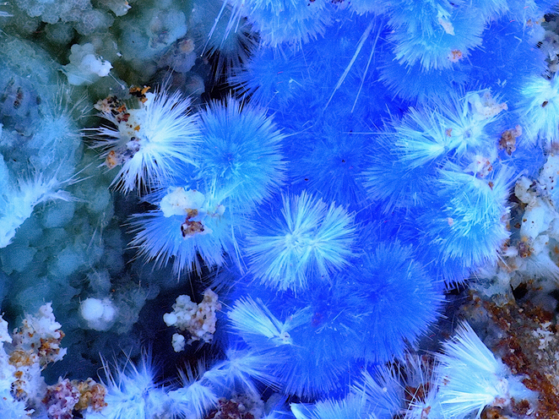
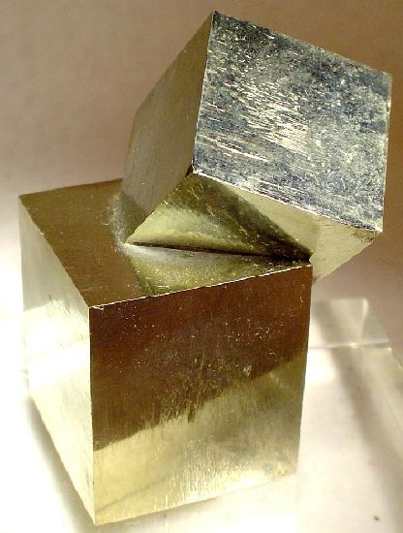
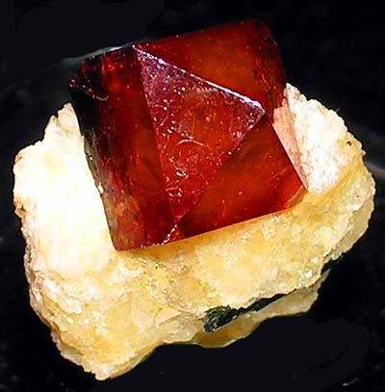
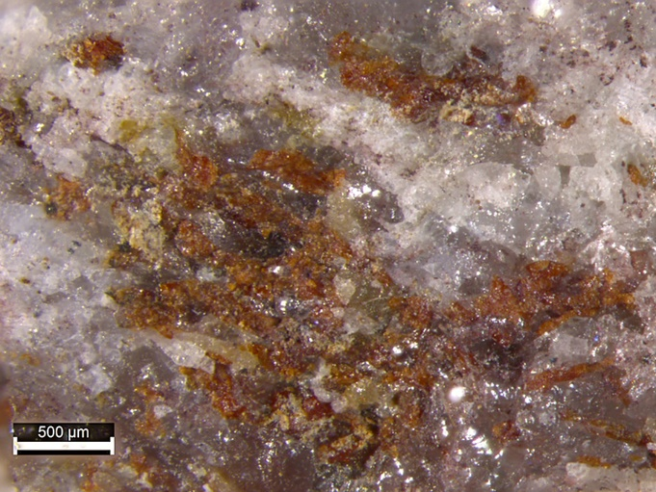
IUCr, direct-space crystal definition:
A solid is a crystal if its atoms, ions and/or molecules form, on average, a long-range ordered arrangement.
Mineralogy
Crystallography
Quartz
Biotite
Pyrite
Cyanotrichite
Aldomarinoite Sr₂Mn³⁺(AsO₄)₂(OH)
(2021)
Zircon
https://www.mindat.org/
Notes:
Cyanotrichite - Cu4Al2(SO4)(OH)12(H2O)2
Zircon - Zr(SiO₄)

Slide 4
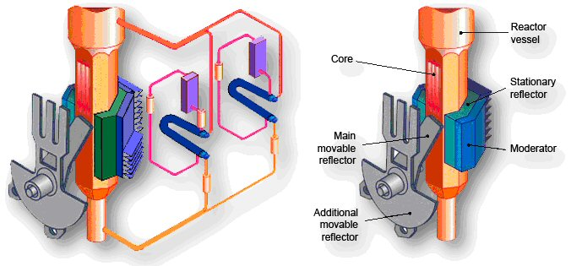
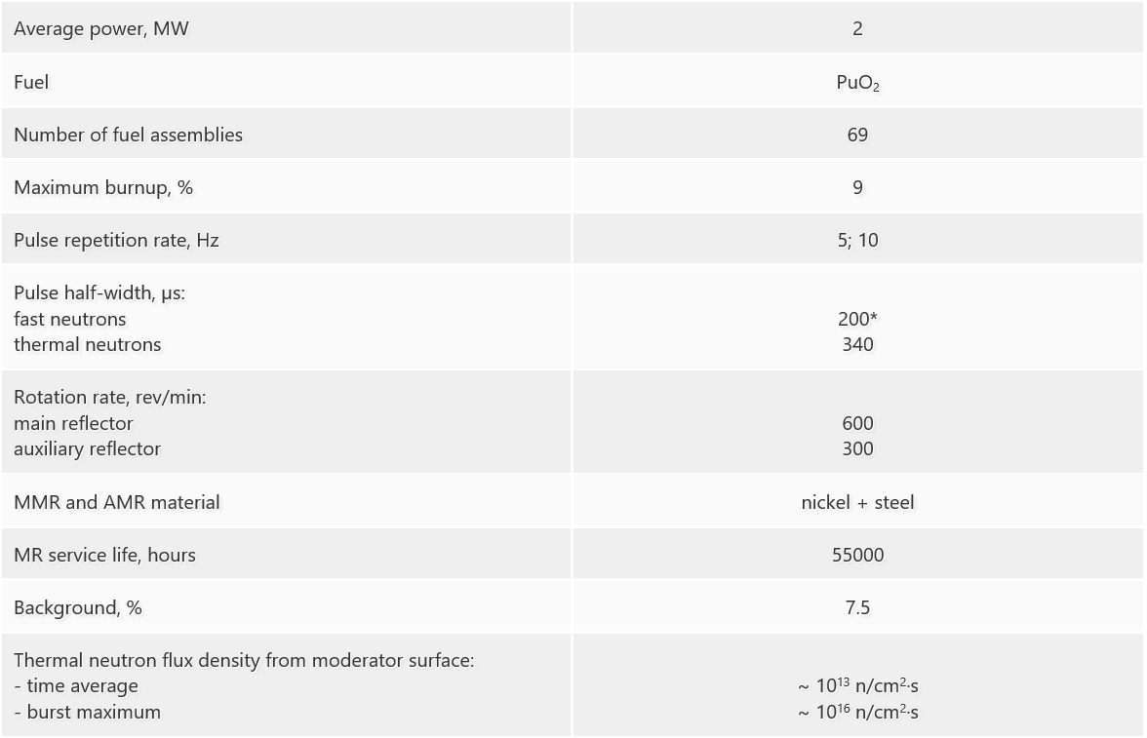
IBR-2
Movable reflector of IBR-2 without shielding (during tests).
The shape of blades greatly affects the width of the neutron pulse.
http://flnph.jinr.ru/en/facilities/ibr-2/parameters

Slide 5
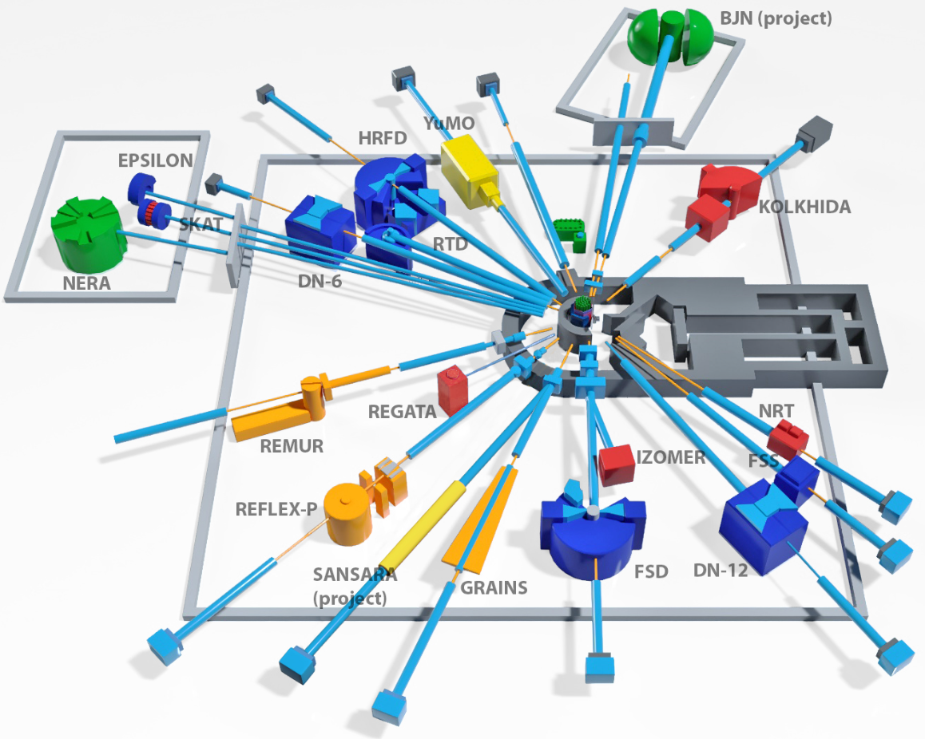
IBR-2
User programme: https://ibr-2.jinr.ru
RSCF infrastructure object: https://grant.rscf.ru/site/user/browse_infra
+ online & on site educational programs

